Slide 1

Chapter 7 – Rupert Brooke
Times and Testimonies
Voices of the Great War

Slide 2
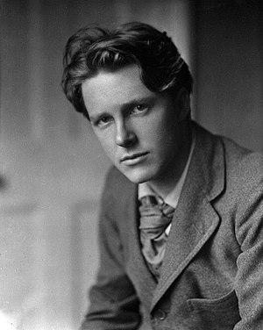
Rupert Brooke (1887-1915)
Was both artistic and a good sportsman
Joined Kings College (Cambridge) on a scholarship
  Nicknamed by his peers as “a young Apollo”
  Published collection of poems in 1911
When the war started: centre of attention in London’s literary scene

Slide 3

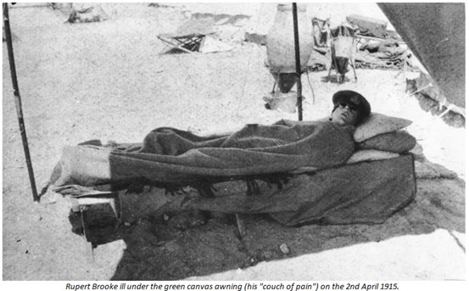
Wartime experiences
“If Armageddon is on, I suppose one should be there”
  Got a commission in 1914 in Royal Naval Division (on land)
  October 1914: embarked for France
Patriotic poems at this time in the war
  Mainly sonnets
  Felt that God wanted him to fight the Germans
February 1915: Brookes’ unit was bound for Gallipoli
  He never reached his destination
  Fell ill → infection caused by mosquito bite
Died on 23 April 1915

Slide 4
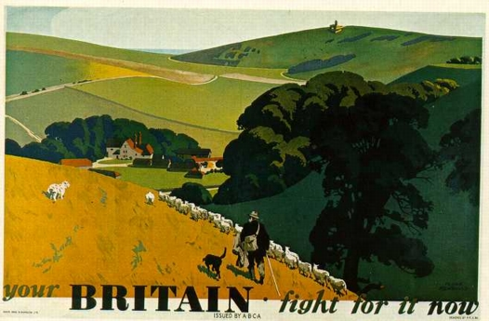
The Soldier

Slide 5

The Soldier
If I should die, think only this of me,
That there's some corner of a foreign field
That is forever England. There shall be
In that rich earth a richer dust concealed;
A dust whom England bore, shaped, made aware,
Gave, once, her flowers to love, her ways to roam,
A body of England's, breathing English air,
Washed by the rivers, blest by suns of home.
And think, this heart, all evil shed away,
A pulse in the eternal mind, no less
Gives somewhere back the thoughts by England given;
Her sights and sounds; dreams happy as her day;
And laughter, learnt of friends; and gentleness,
In hearts at peace, under an English heaven.

Slide 6
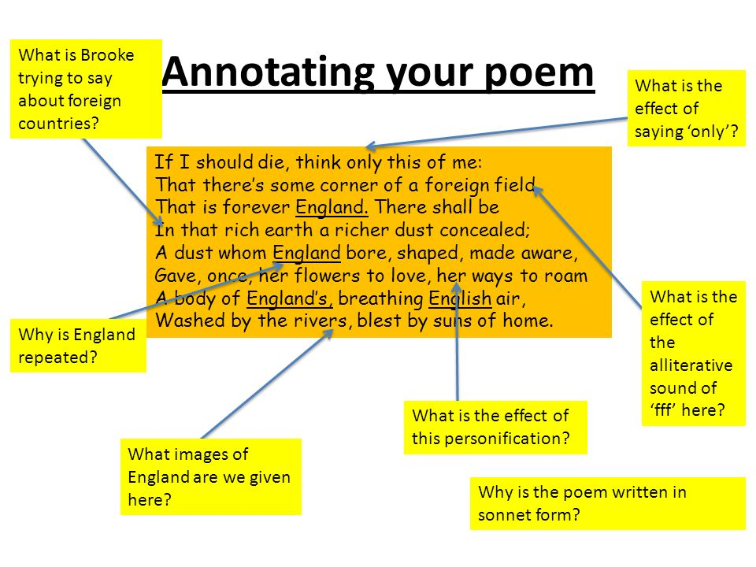

Slide 7
Questions
Indicate the total number of lines per stanza and the rhyme scheme using the letters a - g. What is the form of this poem called?
The narrator had a very happy childhood. What imagery is used to describe the England of his memories?
For what is “dust”(l.5-6) a metaphor?
What will live for ever according to the first two lines of stanza 2? Which words in stanza 2 are associated with this idea?

Slide 8
Answers
Indicate the total number of lines per stanza and the rhyme scheme using the letters a - g. What is the form of this poem called?
The poem is divided in 2 stanzas: one of 8 lines, which is called an ‘octave’ and one of 6 lines, a so-called ‘sestet’. The rhyme scheme is as follows: ababcdcd and efgefg. This rhyme scheme commonly characterises a sonnet, a form of verse with a set number of lines, stanzas, rhyme scheme and metre, introduced into the English language by Shakespeare.

Slide 9
Sonnet
Highly structured poem of 14 lines
Rhyme scheme: ABAB CDCD EFG EFG
Divided into 2 parts:
8 lines → usually describe the problems / ask a question
6 lines → usually describe the solution / answer the question
Iambic pentameter

Slide 10

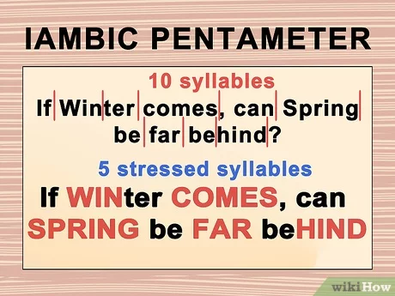

Slide 11
The Soldier
If I should die, think only this of me,
That there's some corner of a foreign field
That is forever England. There shall be
In that rich earth a richer dust concealed;
A dust whom England bore, shaped, made aware,
Gave, once, her flowers to love, her ways to roam,
A body of England's, breathing English air,
Washed by the rivers, blest by suns of home.
And think, this heart, all evil shed away,
A pulse in the eternal mind, no less
Gives somewhere back the thoughts by England given;
Her sights and sounds; dreams happy as her day;
And laughter, learnt of friends; and gentleness,
In hearts at peace, under an English heaven.

Slide 12
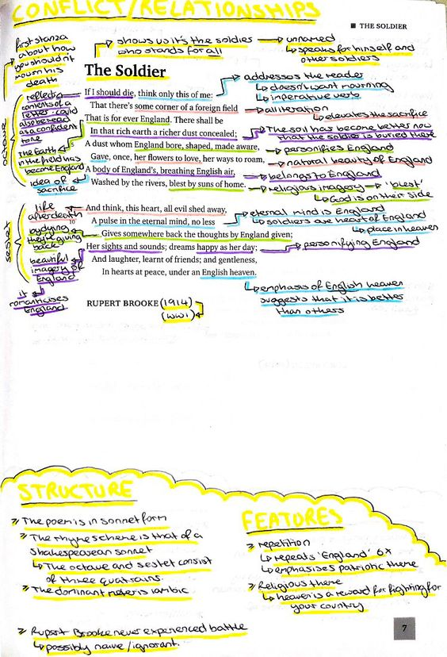

Slide 14
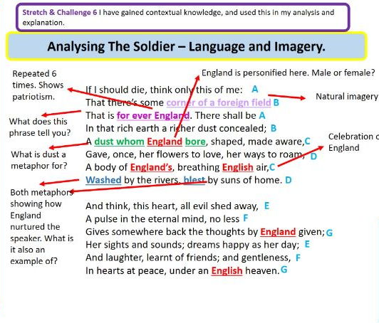

Slide 15
The narrator had a very happy childhood. What imagery is used to describe the England of his memories?
In lines 6 – 9 England is personified as a mother nursing and nurturing her child. Her landscape is described by pastoral, romantic images, such as ‘flowers to love’(l.9), ‘ways to roam’(l.9), ‘breathing English air’(l.8), ‘washed by the rivers’(l.9) and ‘blest by suns of home’(l.9).

Slide 16
For what is “dust”(l.5-6) a metaphor?
The word “dust” is a metaphor for the narrator’s dead body buried there. The adjective ‘richer’ suggest that it adds something extra to the already fertile fields which is explained in lines 12 – 15; “thoughts”, “sights”, “sounds”, “dreams” and “laughter”.

Slide 17
What will live for ever according to the first two lines of stanza 2? Which words in stanza 2 are associated with this idea?
His “heart”(l.10) which will keep beating in the afterlife (“the eternal mind”(l.11)), is a metaphor for his soul.

Slide 18
Write this poem in simpler English
Rules:
No need to rhyme
Sentences don’t need to have the same length
Meaning needs to be the same

